Slide 1
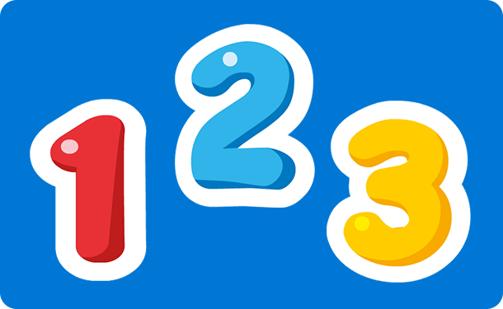
Number Words
two
one
three

Slide 2

Let’s Count To 10
1
2
3
4
5
6
7
8
9
10

Slide 3
Now let’s look at the number words.
1
2
3
4
5
one
two
three
four
five
6
7
8
9
10
six
seven
eight
nine
ten

Slide 4
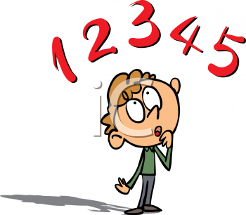
Can you find the correct number word?
1
one
four
nine

Slide 5
Try again

Slide 6
Well done!
Play again

Slide 7
Can you find the correct number word?
6
seven
six
nine

Slide 8
Try again

Slide 9
Well done!
Play again

Slide 10
Can you find the correct number word?
4
one
four
ten

Slide 11
Try again

Slide 12
Well done!
Play again

Slide 13
Can you find the correct number word?
7
five
six
seven

Slide 14
Try again

Slide 15
Well done!
Play again

Slide 16
Can you find the correct number word?
9
nine
eight
seven

Slide 17
Try again

Slide 18
Well done!
Worksheet activity
Finish

Slide 19
Using your worksheet draw lines to the correct number words.
1
2
3
4
5
6
7
8
9
10
one
ten
five
seven
nine
four
six
two
eight
three

Slide 20
Can you follow the arrows to find out if you were right?
1
2
3
4
5
6
7
8
9
10
one
ten
five
seven
nine
four
six
two
eight
three

